Slide 1
Using grep() to subset in R
To easily deal with scale functions

Slide 2
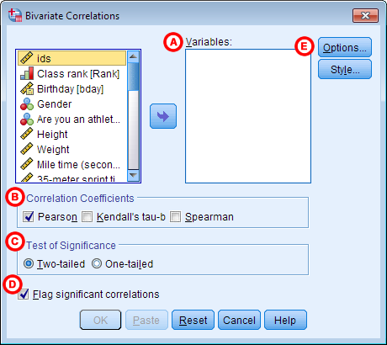
Why we need grep()
In R, we don’t have a dropdown menu to select our variables

Slide 3
Why we need grep()
In R, we don’t have a dropdown menu to select our variables
Because of this, the functions that calculate scales and reliabilities and perform factor analysis take, as input, entire data frames
They assume these data frames have been subset to include only the relevant variables

Slide 4
Scale functions
rowMeans(x, na.rm = TRUE)
Where x is a data frame, averages all the variables in that data frame for each row (usually a participant)
Effectively creates scale scores.

Slide 5
Scale functions
alpha(x, check.keys = TRUE)
Where x is a data frame, finds Cronbach’s alpha coefficient, assuming every variable in that data frame belongs to the same scale.
Also will tell us if variables are reverse-scored if check.keys is TRUE

Slide 6
Scale functions
fa(x, nfactors = 1, rotation = ‘varimax’)
Where x is a data frame, performs exploratory factor analysis, extracting the number of factors specified in the nfactors argument.
Can control various settings like rotation using arguments to the function.

Slide 7
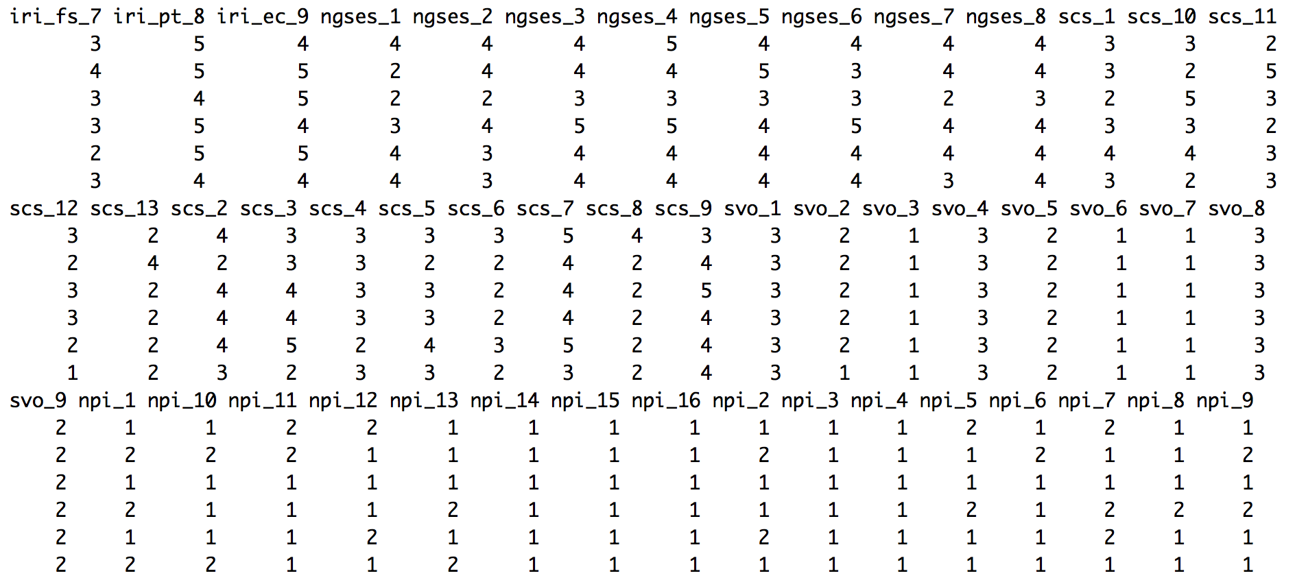
Subsetting by hand…

Slide 8
Understanding grep()
Essentially a function that works like google search
grep(‘pattern’, target) searches for any instances of the string ‘pattern’ within a vector.

Slide 9
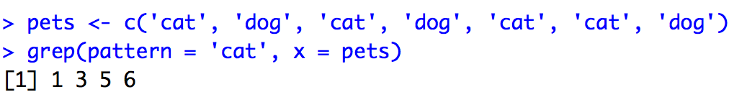
Understanding grep()

Slide 10


Subsetting with grep()

Slide 11
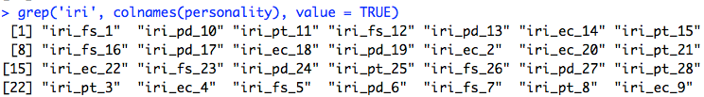
Using grep() with colnames()

Slide 12
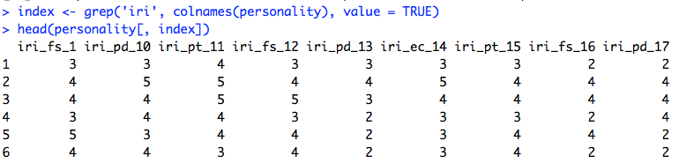
Using grep() with colnames()

Slide 13
Using grep() with colnames()
This combination of functions allows us to flexibly select any subset of similarly named variables in our dataset on the fly
We can then use these subsets as input to functions that expect scale variables as their inputs.

Slide 14
Speeding things up
No need to make selections each time you want to look at a different scale. Just alter the command slightly to search for different variables
alpha(personality[, grep(‘scs’, colnames(personality))]
alpha(personality[, grep(‘iri_pt’, colnames(personality))]
alpha(personality[, grep(‘emexp’, colnames(personality))]

Slide 15
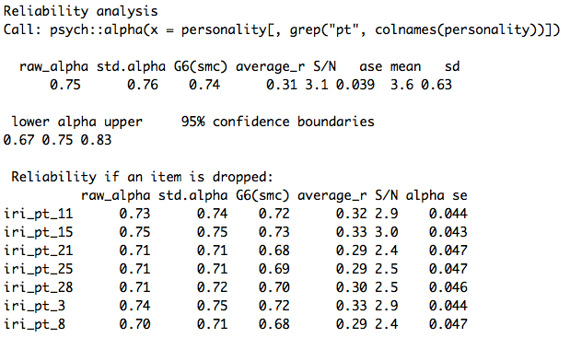
Output from alpha()

Slide 16
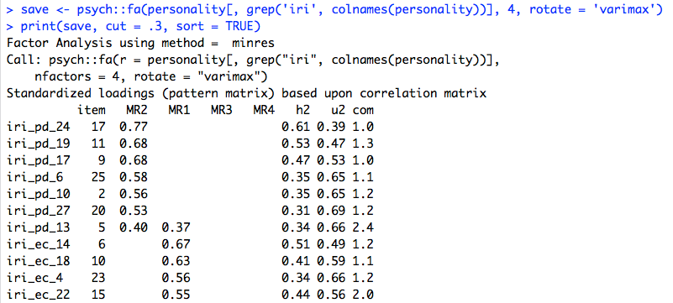
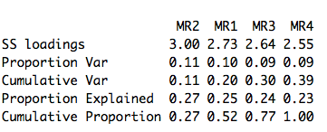
Output from fa()

